Slide 1










Data
Science
PRESENTED BY
- Shubham, Vipul

Slide 2









Flow of Content
Skills needed to become Data Scientist.
Machine Learning in Data Science
What is Data Science ?
It’s Importance
Common Tools & Techniques to Become
Data Scientist

Slide 3


General Terms
Data Analysis
Data Analytics
Analysis is the process of inspecting, cleaning, transforming, and modeling data in order to extract useful information, draw conclusions, and support decision-making
Analytics, on the other hand, is the application of data analysis techniques to solve real-world problems.

Slide 4
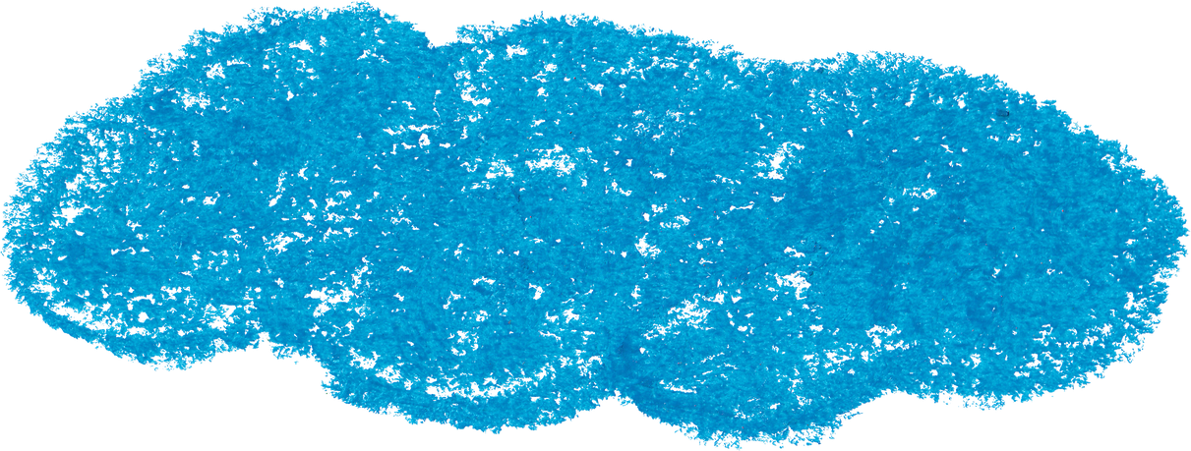





What is Data Science ?
Data science is an interdisciplinary field that combines statistics, mathematics, computer science, and domain expertise to extract insights from data. It involves using various tools and techniques to clean, process, analyze, and visualize data in order to uncover patterns, trends, and relationships.

Slide 5

50
40
Why is Data
Science Important ?
30
20
10
0
Item 1
Item 2
Item 3
Item 4
Item 5

Slide 6


Skills Needed
01
02
03
Mathematics (Probability,
Linear Algebra, Statistics, Calculus
Proficiency in Programming Language (Python, R, SQL)
Databases (MySQL, MongoDB)
04
05
06
Machine Learning Algorithms
Data Cleaning & Visualization Techniques
Big Data Techniques
(Hadoop, Spark)

Slide 7
Some Other Skills
Communication and collaboration – Need to be able to work effectively in teams and communicate their findings to both technical and non-technical stakeholder
Real-world applications – As Used in a wide range of industries such as finance, healthcare, marketing, and sports. Data scientists need to be familiar with the specific challenges and applications in these industries
Continuous learning – As a rapidly evolving field, hence need to be constantly learning and keeping up-to-date with the latest tools and techniques

Slide 8
Machine Learning

Slide 9
Machine Learning
Machine Learning is a subset of Artificial Intelligence that focuses on enabling machines to learn from data, without being explicitly programmed to do so.
It provides systems with the ability to learn and improve their performance on specific tasks, through the analysis of large and complex data sets. This allows for more accurate predictions and decision-making than traditional statistical methods.

Slide 10
Applications of ML
Predictive modeling
Natural Language Processing
Recommender Systems
- this is used to build models that can accurately predict future outcomes based on past data
- this involves the use of Machine Learning to analyze and understand human language, which can be used for chatbots, virtual assistants, and sentiment analysis.
this is used to provide personalized recommendations to users, based on their past behavior or preferences.

Slide 11
Techniques of ML
Supervised Learning
Unsupervised Learning
Reinforcement Learning
- this is where the machine is trained on a set of labeled data, with the goal of predicting future outcomes. This includes classification and regression.
- this is where the machine is trained on a set of unlabeled data, with the goal of finding patterns or relationships in the data.
- this is where the machine learns through trial and error, by receiving feedback based on its actions.

Slide 12
Benefits of Machine Learning
More accurate predictions
Faster decision-making
Personalization
Machine Learning models can be trained on large and complex data sets, which can result in more accurate predictions than traditional statistical methods.
Machine Learning models can analyze data in real-time, allowing for faster decision-making and problem-solving.
Machine Learning can be used to provide personalized recommendations or experiences to users, based on their past behavior or preferences.

Slide 13

Career Opportunities
- Data science is a high-demand field with many career opportunities such as data scientist, data analyst, machine learning engineer, and data engineer.

Slide 14
Conclusion
- Data science is a complex field that requires a wide range of skills and expertise.
- Data scientists play a crucial role in helping businesses and organizations make data-driven decisions, and they need to be able to work with large datasets, machine learning algorithms, and data visualization techniques.

Slide 15



Thank You!
Write a closing statement or call-to-action here.

